Slide 1
Layouts In Next Js

Slide 2
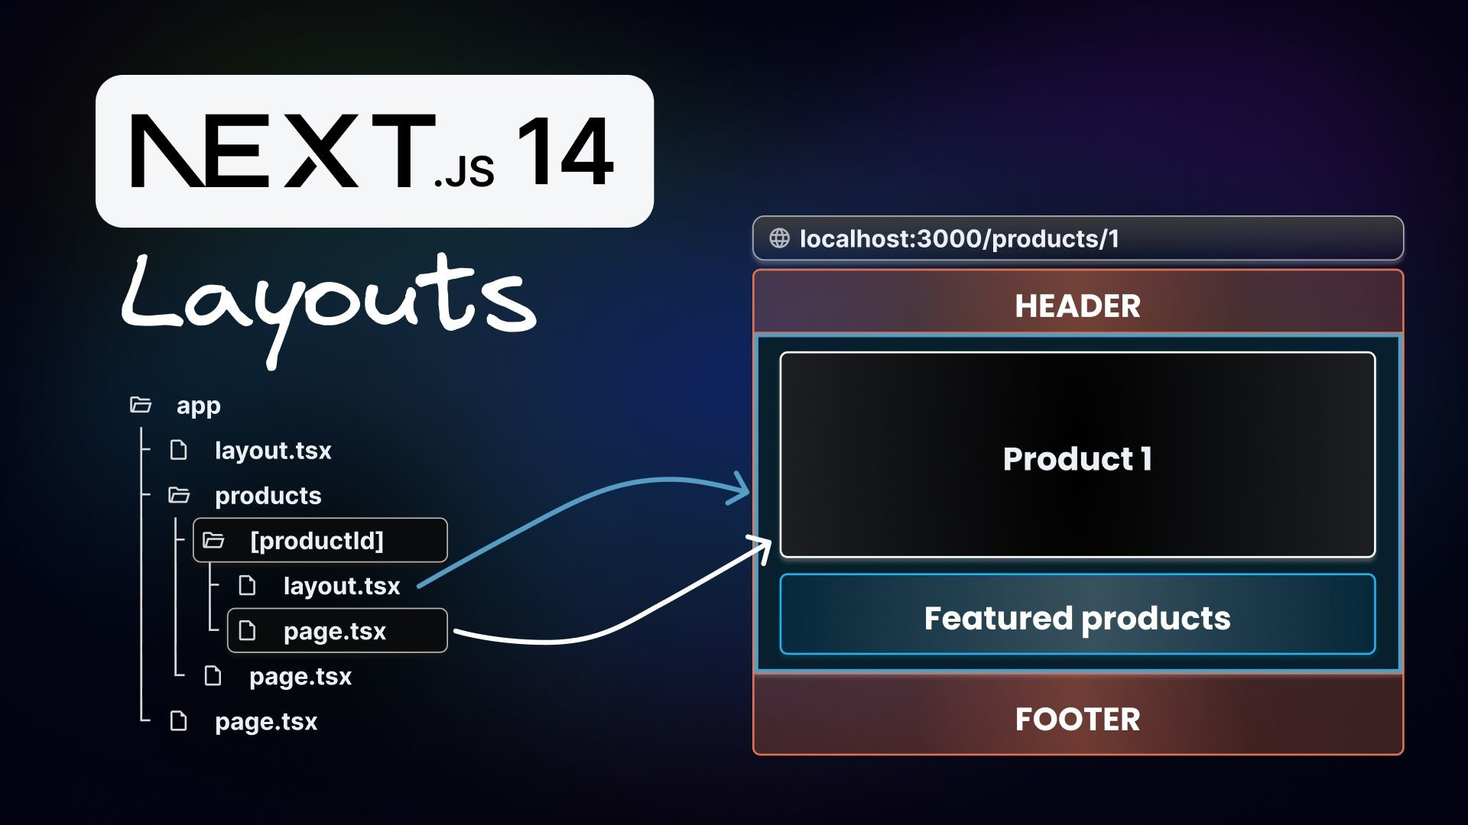
Introduction to Layouts in Next.js
Layouts help manage the structure of your application across different pages.
They allow you to define a consistent look and feel throughout your site.
By using layouts, you can avoid code duplication and streamline your design process.
Notes:
Image source: https://www.builder.io/blog/layouts-in-nextjs-14-visual

Slide 3
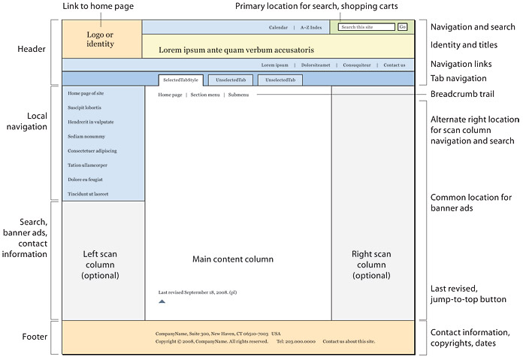
What is a Layout?
A layout is a component that wraps around your pages to provide a common structure.
It typically includes elements like headers, footers, and sidebars.
Layouts can be shared across multiple pages, enhancing maintainability and organization.
Notes:
Image source: https://webstyleguide.com/wsg3/6-page-structure/3-site-design.html

Slide 4
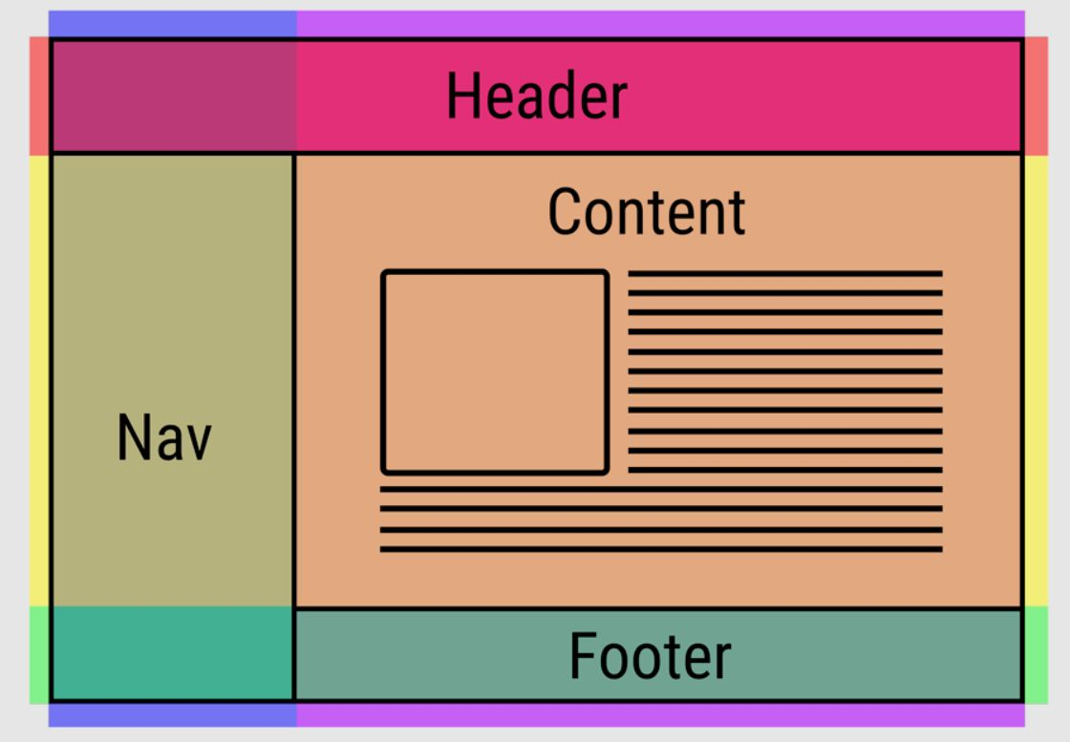
Example of a Simple Layout
Here’s a basic example of a layout component: `const Layout = ({ children }) => { return <div>{children}</div>; };`.
You can enhance this layout by adding a header and footer for better structure.
This layout can then be imported and used in various pages of your Next.js app.
Notes:
Image source: https://alvarotrigo.com/blog/website-layouts/

Slide 5
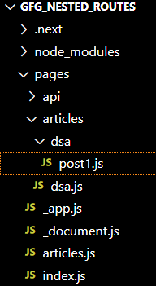
Nested Layouts
Next.js supports nested layouts, allowing for more complex structures.
You can create a layout for a specific section of your application while maintaining a global layout.
This flexibility helps you manage different layouts for different contexts, such as admin and user pages.
Notes:
Image source: https://www.geeksforgeeks.org/next-js-nested-routes/

Slide 6
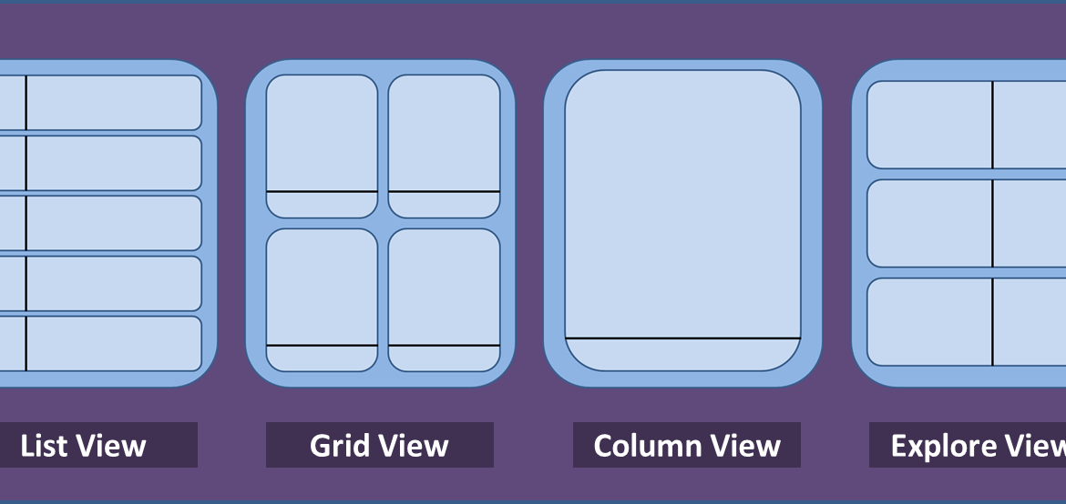
Dynamic Layouts
Dynamic layouts adapt based on the content or context of the page being rendered.
You can conditionally render different layouts by checking page properties or routes.
This allows for a more personalized experience for users depending on their navigation.
Notes:
Image source: http://bicsl.com/introducing-dynamic-layouts/

Slide 7
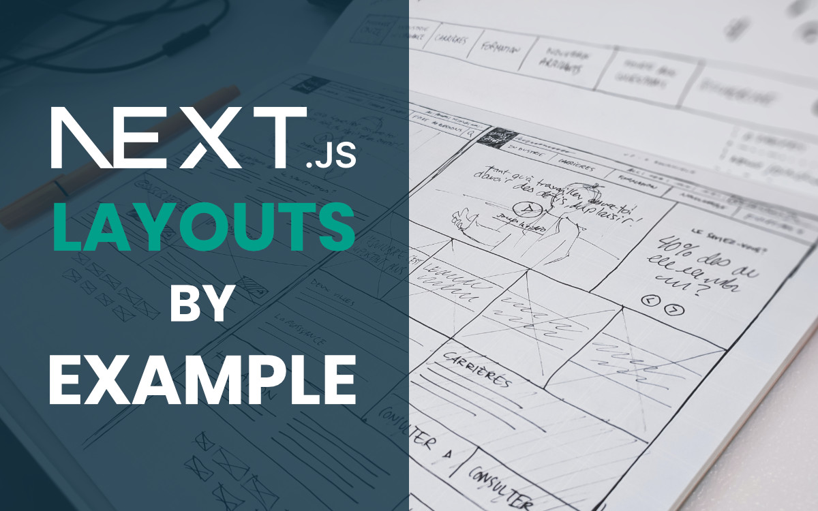
References
Next.js Documentation
https://nextjs.org/docs
React Documentation

